Slide 1










DSAA Tutorial 2025: Time Series Classification: an Overview of Current Research and Solutions for Imperfect Data
Matthew Middlehurst
Tony Bagnall
Germain Forestier
Ali Ismail-Fawaz
Arik Ermhaus

Slide 2












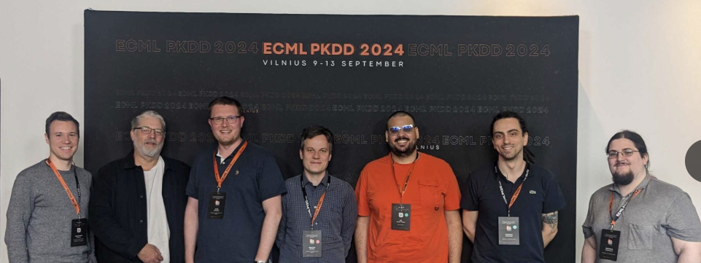





Ali Ismail-Fawaz
Matthew Middlehurst
Germain Forestier
Antoine Guillaume
Tony Bagnall
Chris Holder
Leo Tsaprounis
Patrick Schäfer
Sebastian Schmidl
David Guijo Rubio
Divya Tiwari
David Djuigo
Aadya Chinubhai

Slide 3
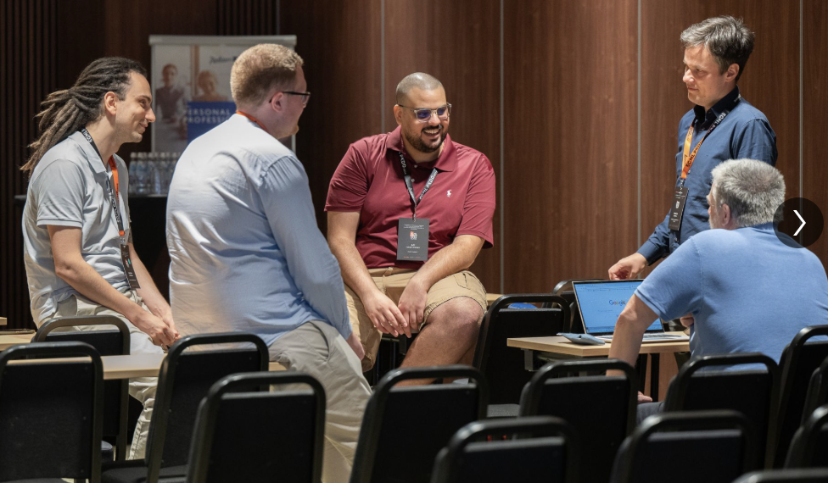
A python toolkit for time series machine learning and deep learning
A framework for reproducible research into Time Series Machine Learning (TSML)
Easy access to the latest state-of-the-art TSML algorithms for practitioners
Reduce entry barriers into the numerous fields of research in TSML

Slide 4
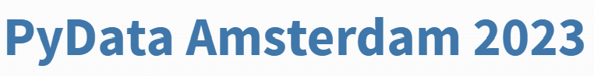





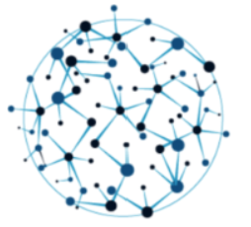
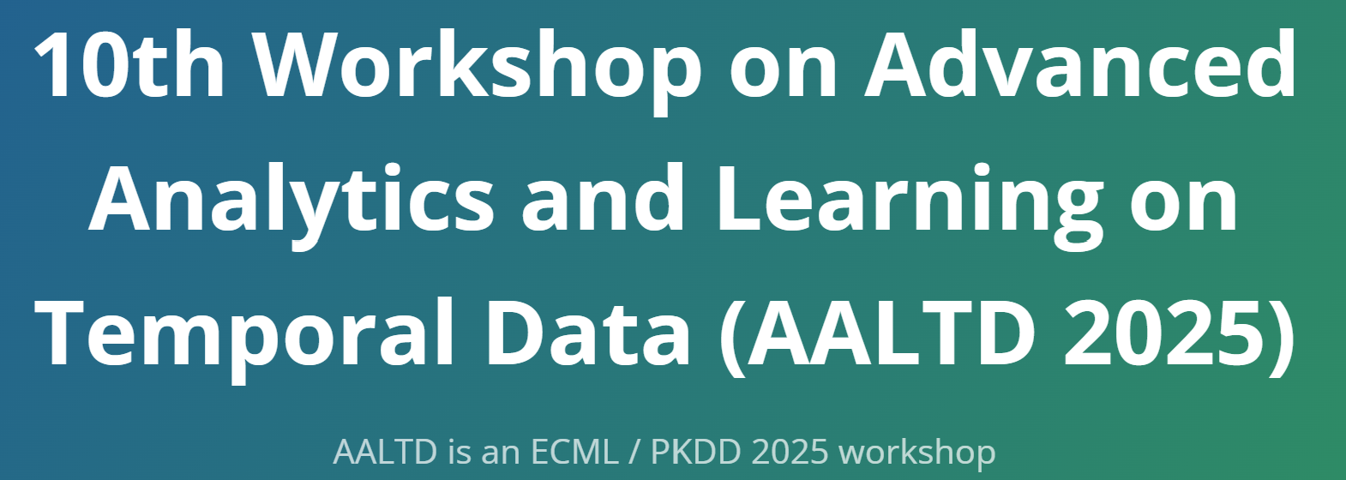

Time Series Machine Learning Roadshow
https://github.com/aeon-toolkit/aeon-tutorials

Slide 5
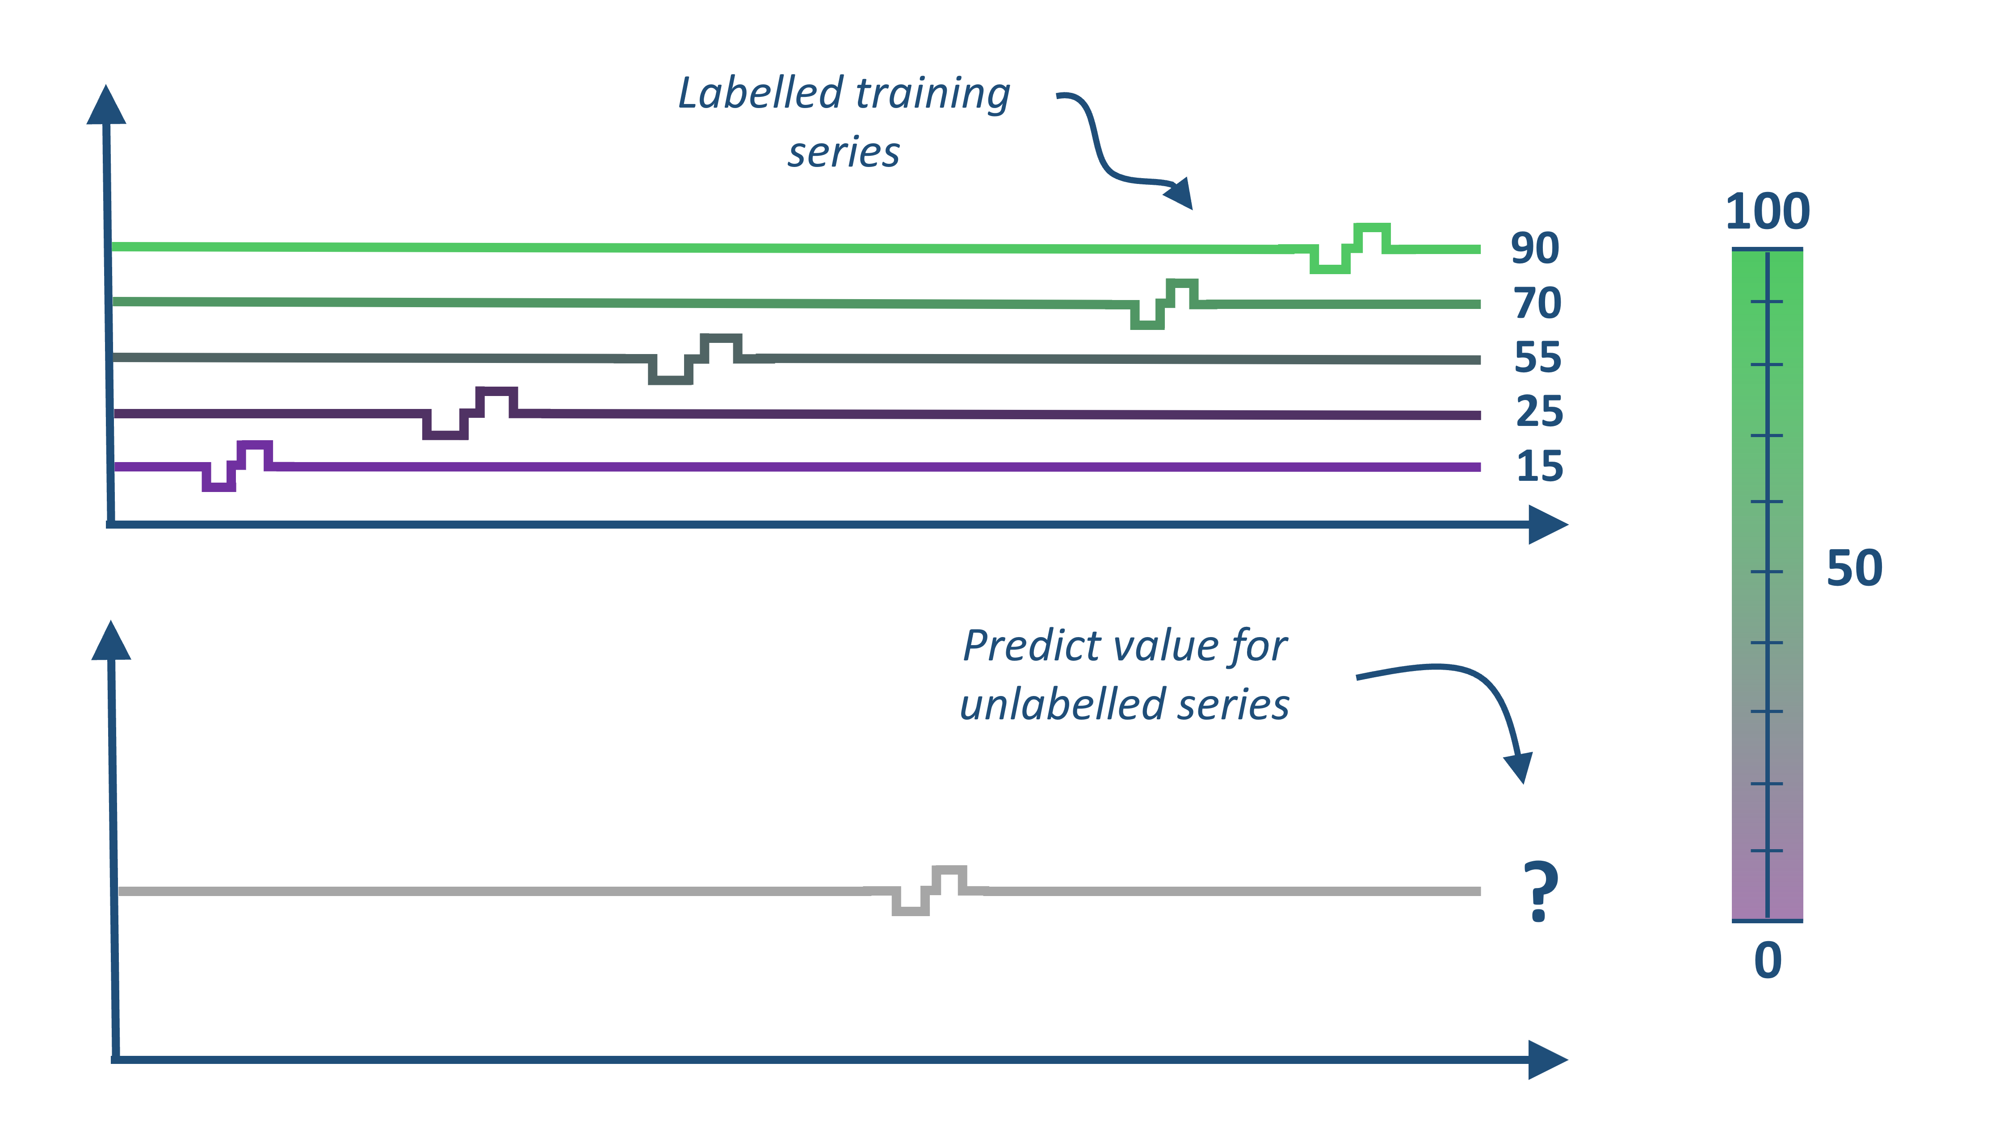
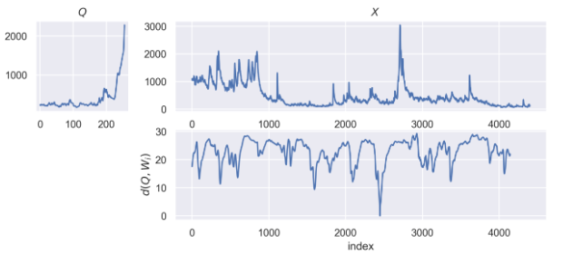
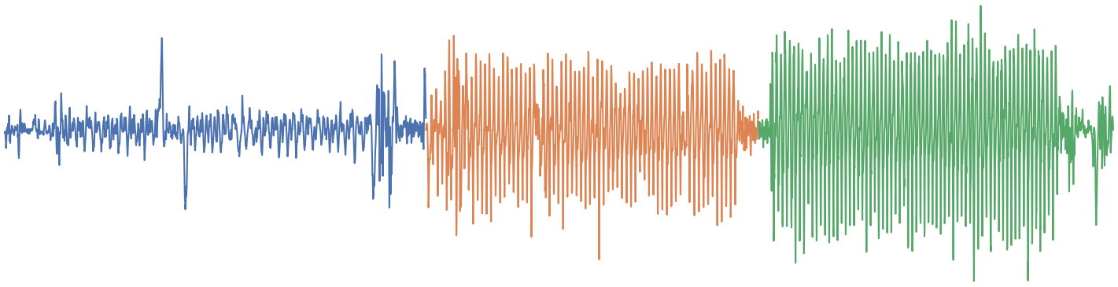
Time Series Machine Learning Tasks
Classification
Regression
Clustering
Labelled training series
Classify unlabelled series
?
Anomaly Detection
Similarity Search
Segmentation
Deep learning
Forecasting

Slide 6
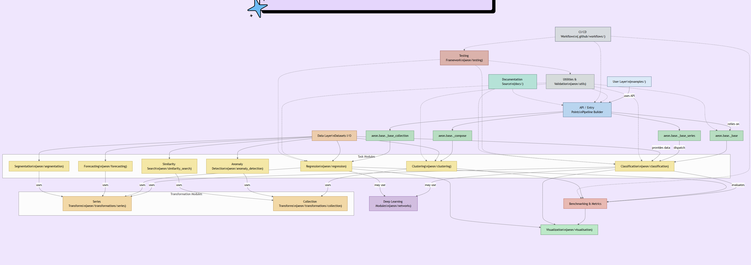
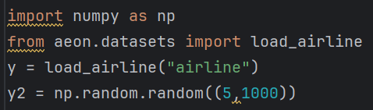
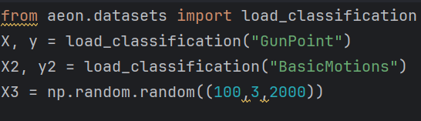
Single time series
Collections of time series
numpy array, shape (n_channels, n_timepoints)
numpy array, shape
(n_cases, n_channels, n_timepoints)
Or list of 2D numpy array
BaseSeriesEstimator
transformations
BaseCollectionEstimator
Similarity search
distances
Regression
Segmentation
networks
Classification
Forecasting
Anomaly detection
visualisation
Clustering

Slide 7



aeon history
Rebranded as aeon, new repository
Join NumFOCUS as affiliate member
3 GSoC students with NumFOCUS
Begun as part of a program grant at the Alan Turing Institute
2019
2020
2021
2022
2023
2024
Tutorials at SIGKDD and ECML-PAKDD
3 year research grant for call for “Software for research communities”

Slide 8

aeon functionality
Forecasting and classification
Distances and clustering
Similarity search
Segmentation
2019
2020
2021
2022
2023
2024
More classifiers
Deep learning
Anomaly detection
Regression
Remove legacy forecasting module, refactor
Multivariate classification

Slide 9



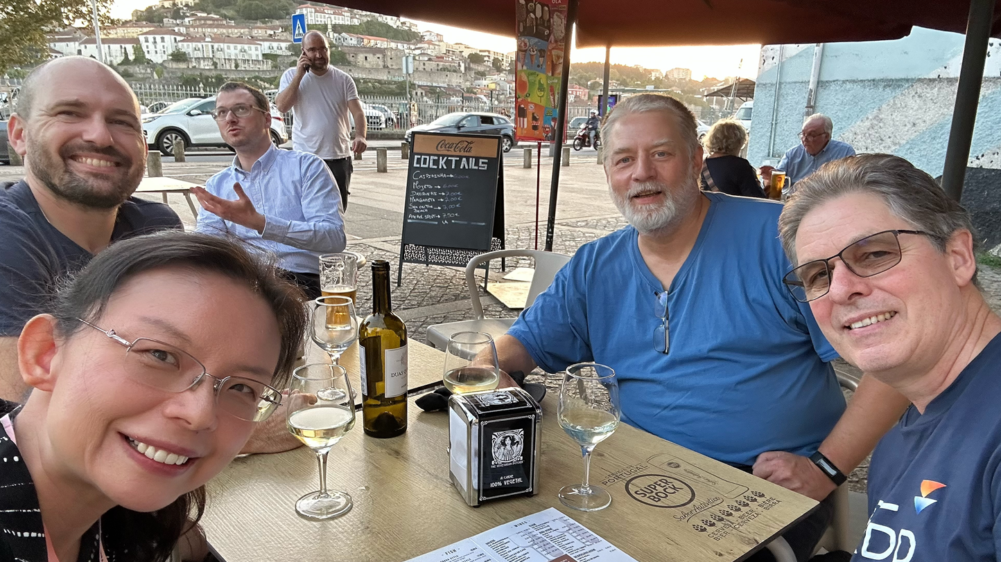

2025
INRIA project begins
Scikit Learn (SNRIA 'Project P16'), an open source software infrastructure for AI
Release Version 1.0
Present at two ML conferences and forecasting workshop
new imbalance module
Jan
March
June
October
Apply for full membership of NumFOCUS
new forecasting module
Two Google Summer of Code projects

Slide 10
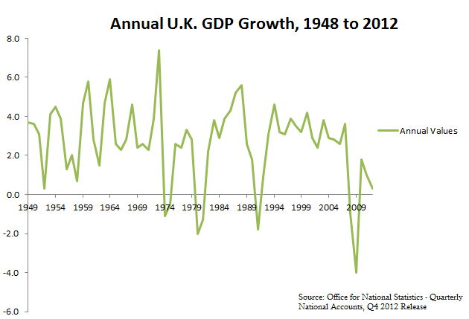
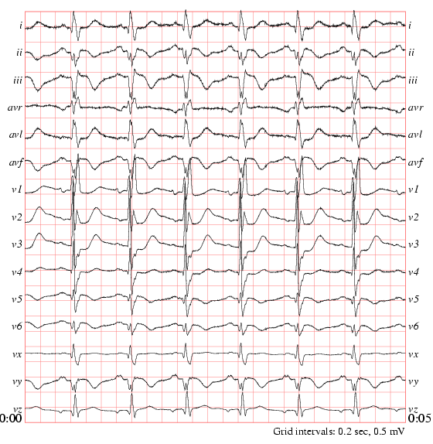

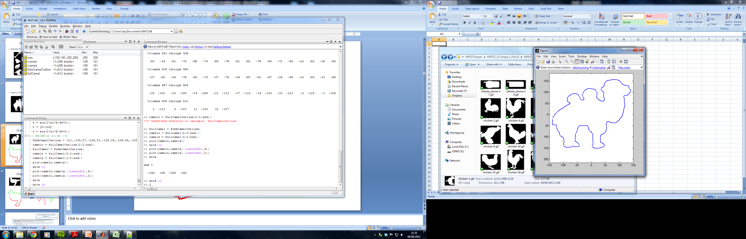
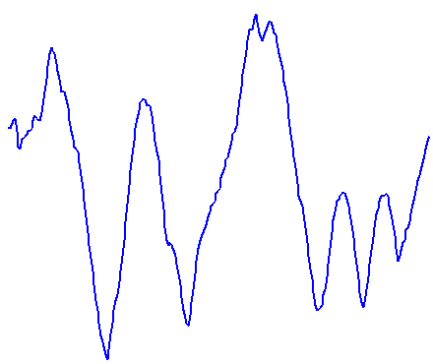
What is a time series?
A time series is an ordered list of observations of real valued variable(s)
If each observation is a scalar, we call it a univariate time series
If each observation is a vector of observations we call it a multivariate time series
The data does not need be ordered in time (sometimes called a data series)
We may have one series, or a collection of series
We may have unequal length, missing values, different sampling rates …..

Slide 11
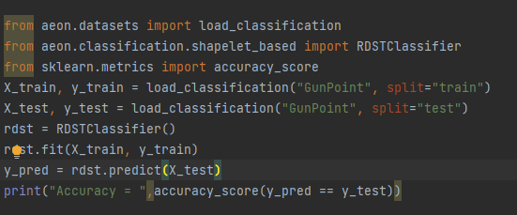
classification
regression
clustering
aeon clusterers, classifiers and regressors are compatible with sklearn

Slide 12

Schedule
09:00 Introduction to time series classification and aeon
09:10-9:50 Time series classification algorithms
09:50-10:30 Deep learning for time series classification -
Break (10:30, 30 Minutes)
11:00 -11:25 Segmentation of time series for classification
11:25-11:50 Recent advances for unequal length, unbalanced and high dimensional time series
11:50 -12:00 Conclusion/Q&A

